Slide 1
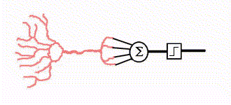
ECE 471/571 – Lecture 15
Use Neural Networks for Pattern Recognition
10/20/14

Slide 2

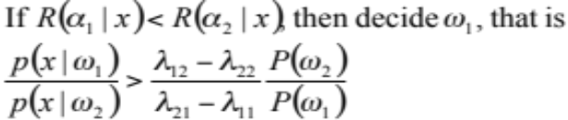

Recap
Pattern Classification
Statistical Approach
Syntactic Approach
Supervised
Unsupervised
Basic concepts:
Baysian decision rule
(MPP, LR, Discri.)
Parametric learning (ML, BL)
Non-Parametric learning (kNN)
LDF (Perceptron)
Three cases
NN (BP)
Dimensionality Reduction
Fisher’s linear discriminant
K-L transform (PCA)
Performance Evaluation
ROC curve
TP, TN, FN, FP
Stochastic Methods
local optimization (GD)

Slide 3
Definitions
According to the DARPA Neural Network Study (1988, AFCEA International Press, p. 60):
  ... a neural network is a system composed of many simple processing elements operating in parallel whose function is determined by network structure, connection strengths, and the processing performed at computing elements or nodes.
According to Haykin, S. (1994), Neural Networks: A Comprehensive Foundation, NY: Macmillan, p. 2:
  A neural network is a massively parallel distributed processor that has a natural propensity for storing experiential knowledge and making it available for use. It resembles the brain in two respects:
    Knowledge is acquired by the network through a learning process.
    Interneuron connection strengths known as synaptic weights are used to store the knowledge.

Slide 4

Why NN?
Human brain is very good at pattern recognition and generalization
Derive meaning from complicated or imprecise data
A trained neural network can be thought of as an "expert" in the category of information it has been given to analyze.
Adaptive learning
Self-Organization
Real Time Operation
  Parallel processing
Fault Tolerance
  Redundancy vs.
  Regeneration

Slide 5
Key Application Areas
Identify pattern and trends in data
Examples:
  Recognition of speakers in communications
  Diagnosis of hepatitis
  Recovery of telecommunications from faulty software
  Interpretation of multimeaning Chinese words
  Undersea mine detection
  Texture analysis
  Object recognition; handwritten word recognition; and facial recognition.

Slide 6
NN - A Bit History
http://www.doc.ic.ac.uk/~nd/surprise_96/journal/vol1/cs11/article1.html
http://www.neurocomputing.org
First Attempts
  Simple neurons which are binary devices with fixed thresholds – simple logic functions like “and”, “or” – McCulloch and Pitts (1943)
Promising & Emerging Technology
  Perceptron – three layers network which can learn to connect or associate a given input to a random output - Rosenblatt (1958)
  ADALINE (ADAptive LInear Element) – an analogue electronic device which uses least-mean-squares (LMS) learning rule – Widrow & Hoff (1960)
Period of Frustration & Disrepute
  Minsky & Papert’s book in 1969 in which they generalized the limitations of single layer Perceptrons to multilayered systems.
  “...our intuitive judgment that the extension (to multilayer systems) is sterile”
Innovation
  Grossberg's (Steve Grossberg and Gail Carpenter in 1988) ART (Adaptive Resonance Theory) networks based on biologically plausible models.
  Anderson and Kohonen developed associative techniques
  Klopf (A. Henry Klopf) in 1972, developed a basis for learning in artificial neurons based on a biological principle for neuronal learning called heterostasis.
  Werbos (Paul Werbos 1974) developed and used the back-propagation learning method
  Fukushima’s (F. Kunihiko) cognitron (a step wise trained multilayered neural network for interpretation of handwritten characters).
Re-Emergence

Slide 7
A Wrong Direction
One argument: Instead of understanding the human brain, we understand the computer. Therefore, NN dies out in 70s.
1980s, Japan started “the fifth generation computer research project”, namely, “knowledge information processing computer system”. The project aims to improve logical reasoning to reach the speed of numerical calculation. This project proved an abortion, but it brought another climax to AI research and NN research.

Slide 8
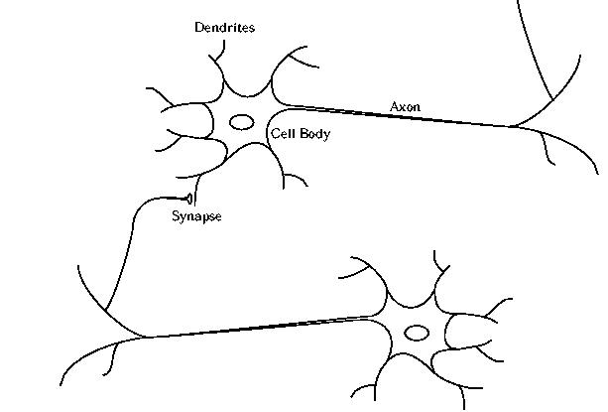
Biological Neuron
Dendrites: tiny fibers which carry signals to the neuron cell body
Cell body: serves to integrate the inputs from the dendrites
Axon: one cell has a single output which is axon. Axons may be very long (over a foot)
Synaptic junction: an axon impinges on a dendrite which causes input/output signal transitions

Slide 9
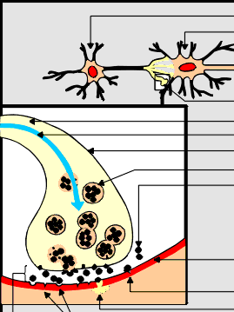
Synapse
http://faculty.washington.edu/chudler/chnt1.html
Communication of information between neurons is accomplished by movement of chemicals across the synapse.
The chemicals are called neurotransmitters (generated from cell body)
The neurotransmitters are released from one neuron (the presynaptic nerve terminal), then cross the synapse and are accepted by the next neuron at a specialized site (the postsynaptic receptor).

Slide 10
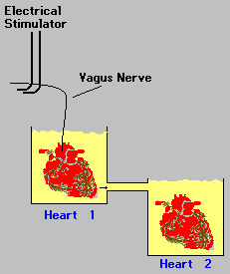
The Discovery of Neurotransmitters
Otto Loewi's Experiment (1920)
Heart 1 is connected to vagus nerve, and is put in a chamber filled with saline
Electrical stimulation of vagus nerve causes heart 1 to slow down. Then after a delay, heart 2 slows down too.
Acetylcholine
Notes:
Back in 1921, an Austrian scientist named Otto Loewi discovered the first neurotransmitter.In his experiment (which came to him in a dream), he used two frog hearts. One heart (heart #1) was still connected to the vagus nerve. Heart #1 was placed in a chamber that was filled with saline. This chamber was connected to a second chamber that contained heart #2. So, fluid from chamber #1 was allowed to flow into chamber #2. Electrical stimulation of the vagus nerve (which was attached to heart #1) caused heart #1 to slow down. Loewi also observed that after a delay, heart #2 also slowed down. From this experiment, Loewi hypothesized that electrical stimulation of the vagus nerve released a chemical into the fluid of chamber #1 that flowed into chamber #2. He called this chemical "Vagusstoff". We now know this chemical as the neurotransmitter called acetylcholine.

Slide 11
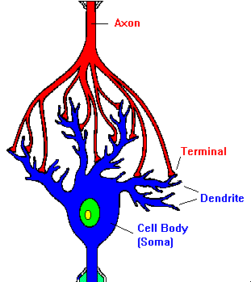
Action Potential
When a neurotransmitter binds to a receptor on the postsynaptic side of the synapse, it results in a change of the postsynaptic cell's excitability: it makes the postsynaptic cell either more or less likely to fire an action potential. If the number of excitatory postsynaptic events are large enough, they will add to cause an action potential in the postsynaptic cell and a continuation of the "message."
Many psychoactive drugs and neurotoxins can change the properties of neurotransmitter release, neurotransmitter reuptake and the availability of receptor binding sites.

Slide 12
Storage of Brain
An adult nervous system possesses 10¹⁰ neurons.
With 1000 synapses per neuron, and 8 bits of storage per synapse ➔
10 terabytes of storage in your brain!
Einstein’s brain
  Unusually high number of glial cells in his parietal lobe (glial cells are the supporting architecture for neurons)
  Extensive dendrite connectivity
  Whenever anything is learned, there are new dendrite connections made between neurons

Slide 13
ANN

Slide 14
Types of NN
Recurrent (feedback during operation)
  Hopfield
  Kohonen
  Associative memory
Feedforward
  No feedback during operation (only during determination of weights)
  Perceptron
  Back propagation

